Slide 1
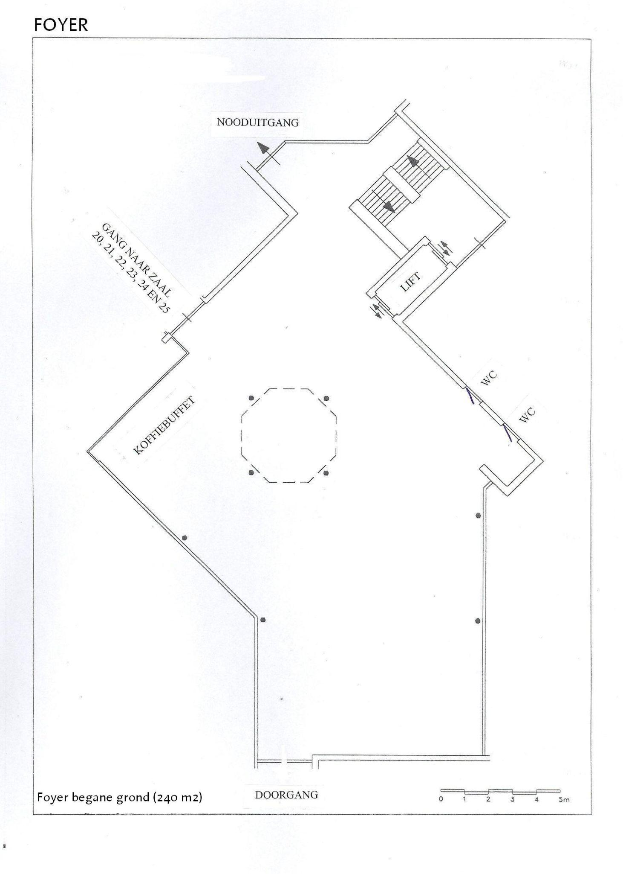
FOYER GROUND FLOOR
Neurodegeneration & aging [N = (19/18)]
N posters = 37 (19/18)
N boards = 20
2025:
Poster boards: 20
Poster room: 19
Poster numbers: 1 t/m 37
2
21
1
20
3
19
22
23
4
5
24
25
6
18
37
17
27
36
9
7
16
28
8
26
35
30
10
12
29
11
31
33
Day1
Day2
15
13
34
14
32

Slide 2
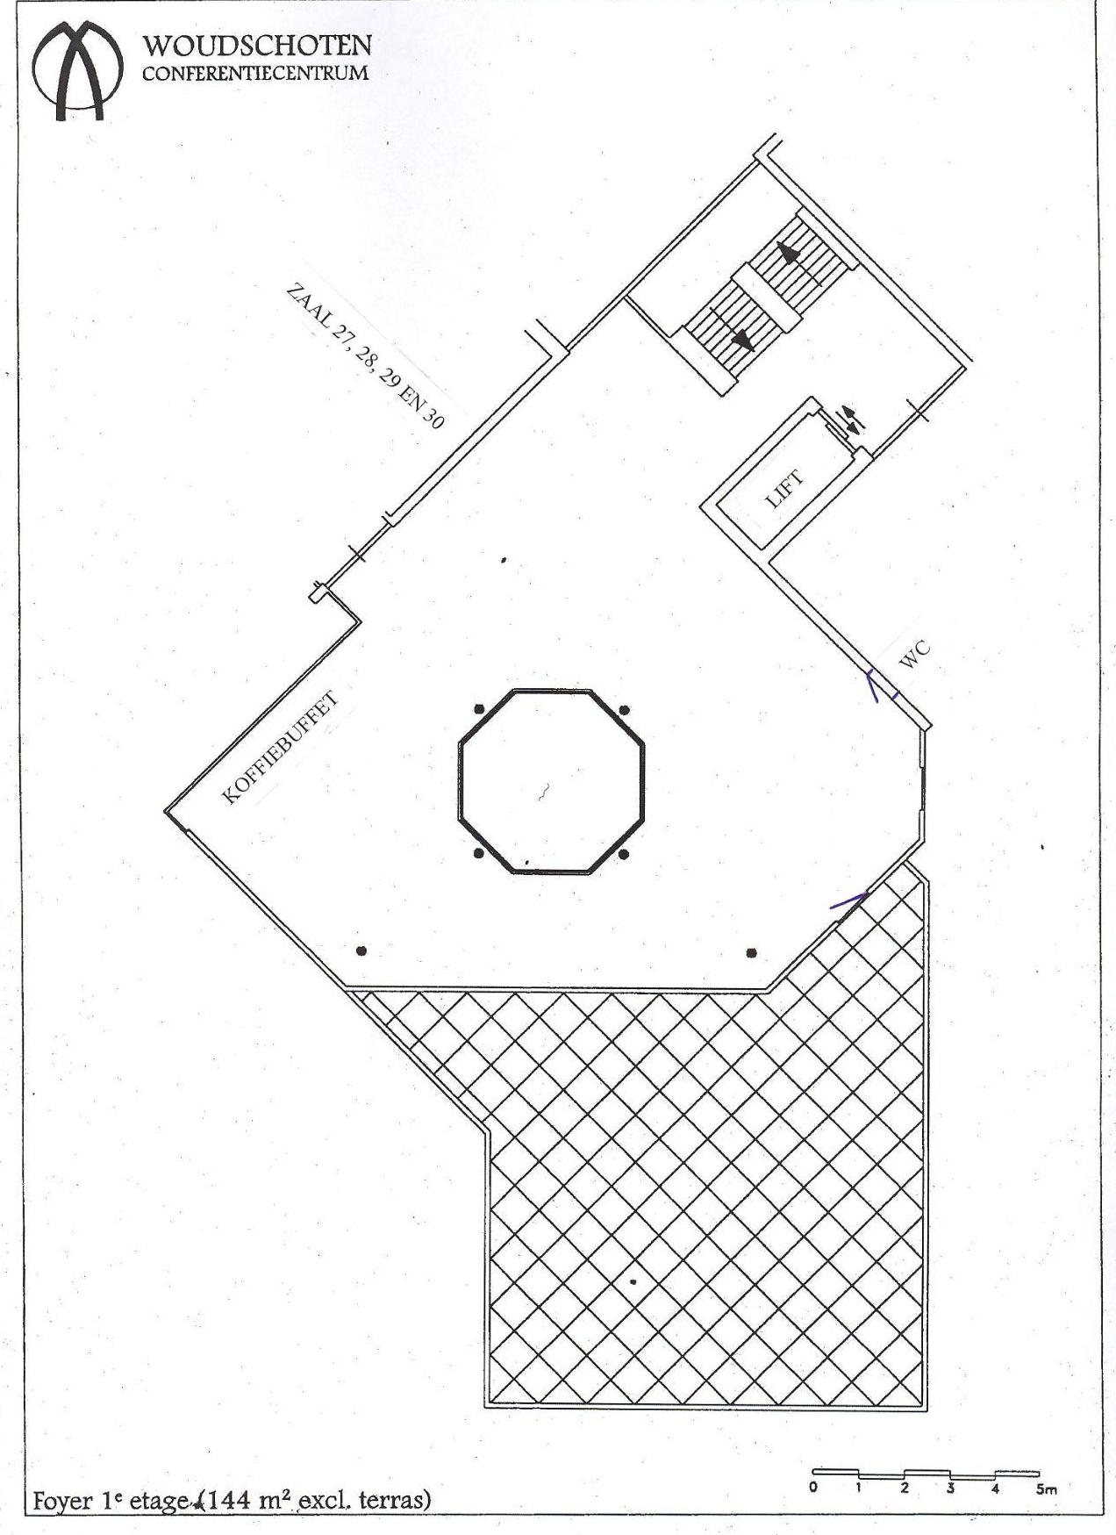
FOYER TOP FLOOR
Neurodegeneration & aging [N = 5 (3/2)]
Epilepsy [N = 5 (1/4)]
Demyelinating disorders [N = 4 (3/1)]
N posters = 14 (7/7)
N boards = 7
Poster numbers: 38 t/m 51
45
38
46
39
51
44
50
43
49
40
42
47
41
48
Day1
Day2

Slide 3
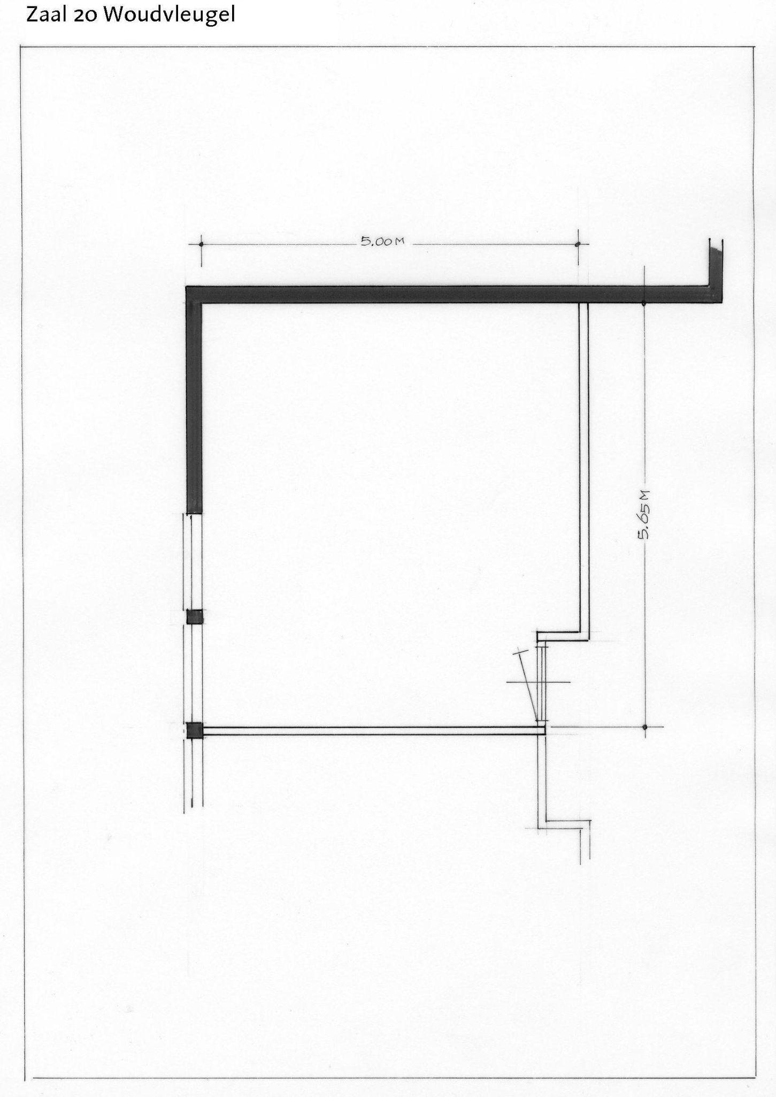
Cellular mechanisms [N = 12 (8/4)]
N posters = 12
N boards = 6
Poster numbers: 52 t/m 63
53
63
52
62
58
54
57
59
61
55
56
60
Day1
Day2
Notes:
8

Slide 4
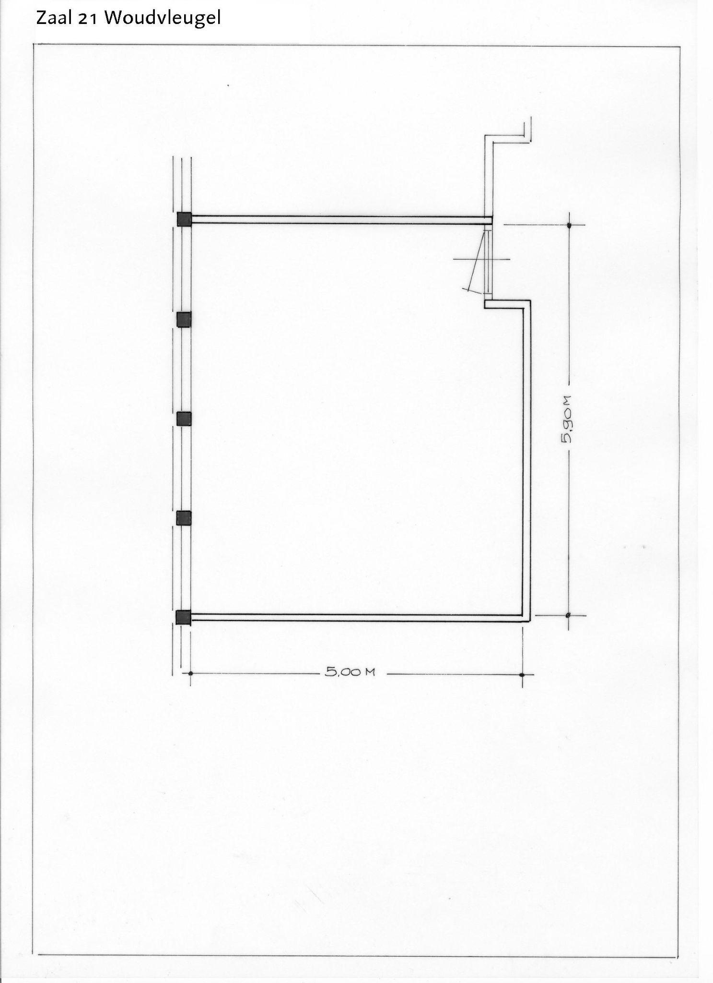
Development + developmental disorders
N posters = 12 [6/6]
N boards = 6
Poster numbers: 64 t/m 75
73
64
67
70
72
65
66
71
68
74
69
75
Day1
Day2
Notes:
8

Slide 5
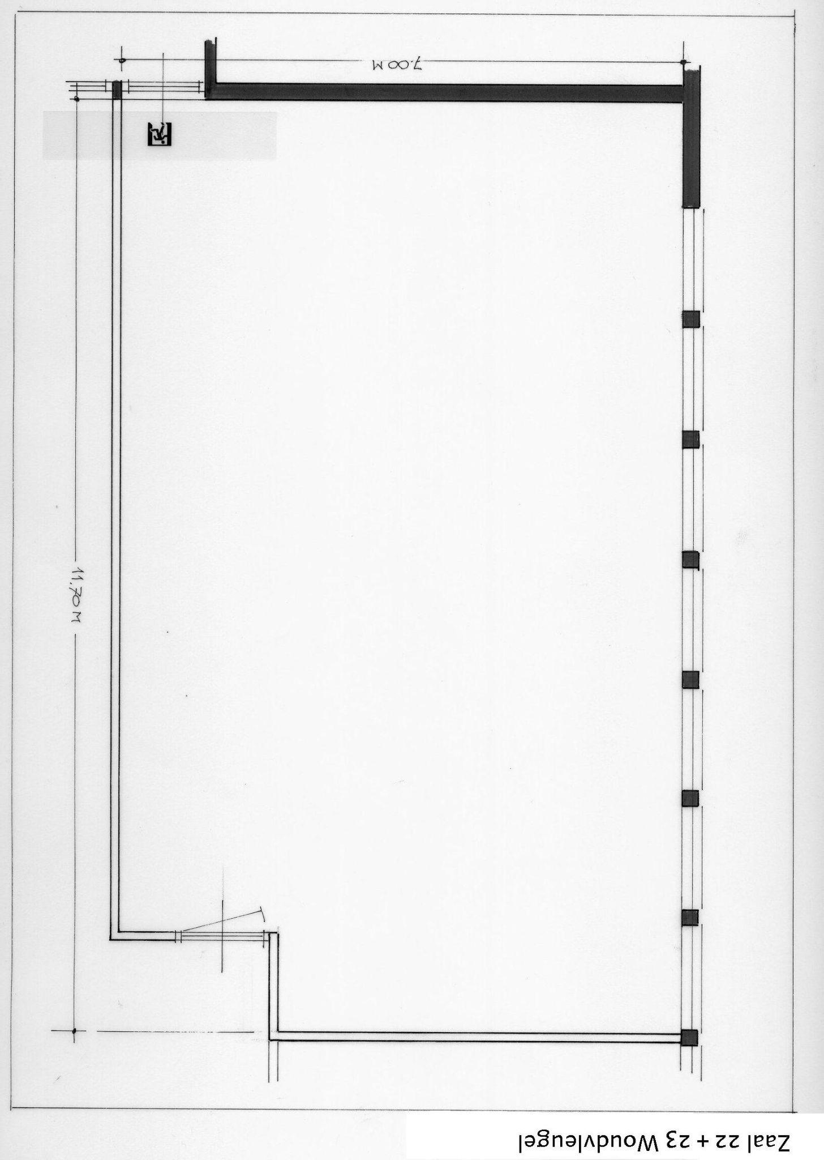
77
89
76
88
Sensory and motor systems + integrative systems [N = 24 (12/7)]
N posters = 24
N boards = 13
Poster numbers: 76 t/m 99
90
78
99
94
91
82
83
79
84
98
87
95
97
85
86
96
92
80
93
81
Day1
Day2

Slide 6
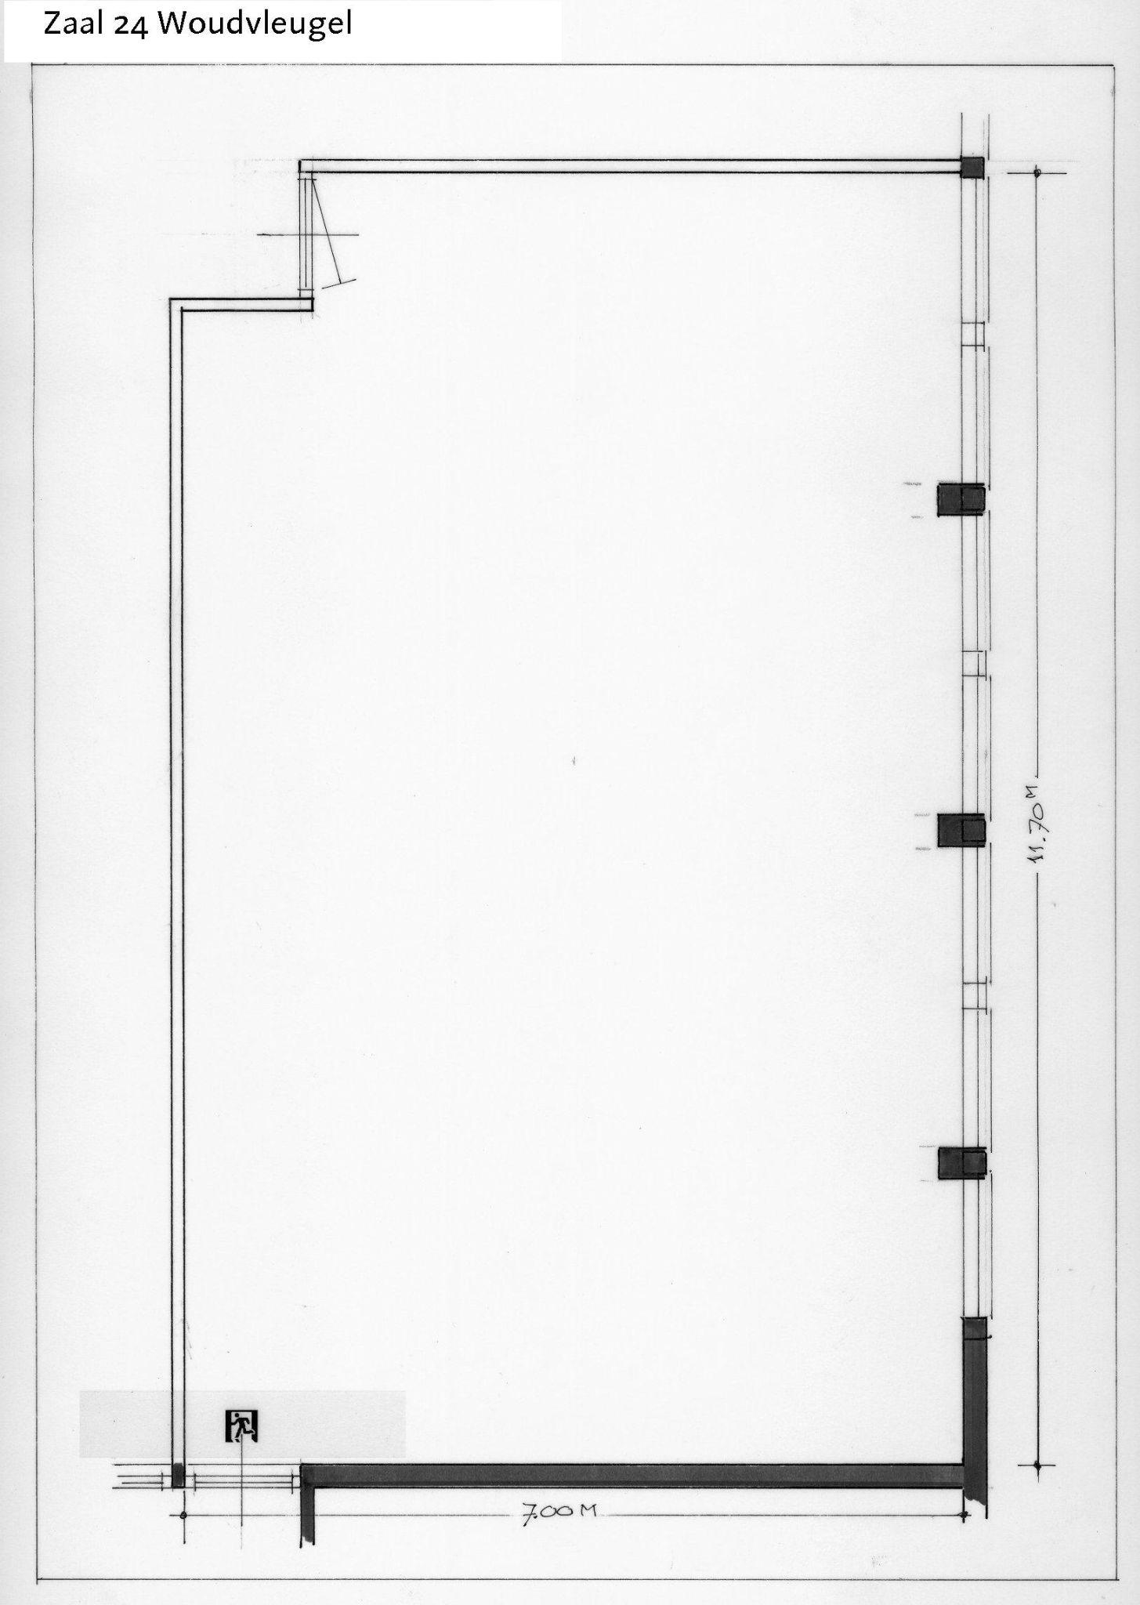
109
100
115
Cognitive
[N=16 (9/7)]
N posters = 16
N boards = 10
Poster numbers: 100 t/m 115
101
106
110
108
107
102
105
111
114
112
103
113
104
Day1
Day2

Slide 7
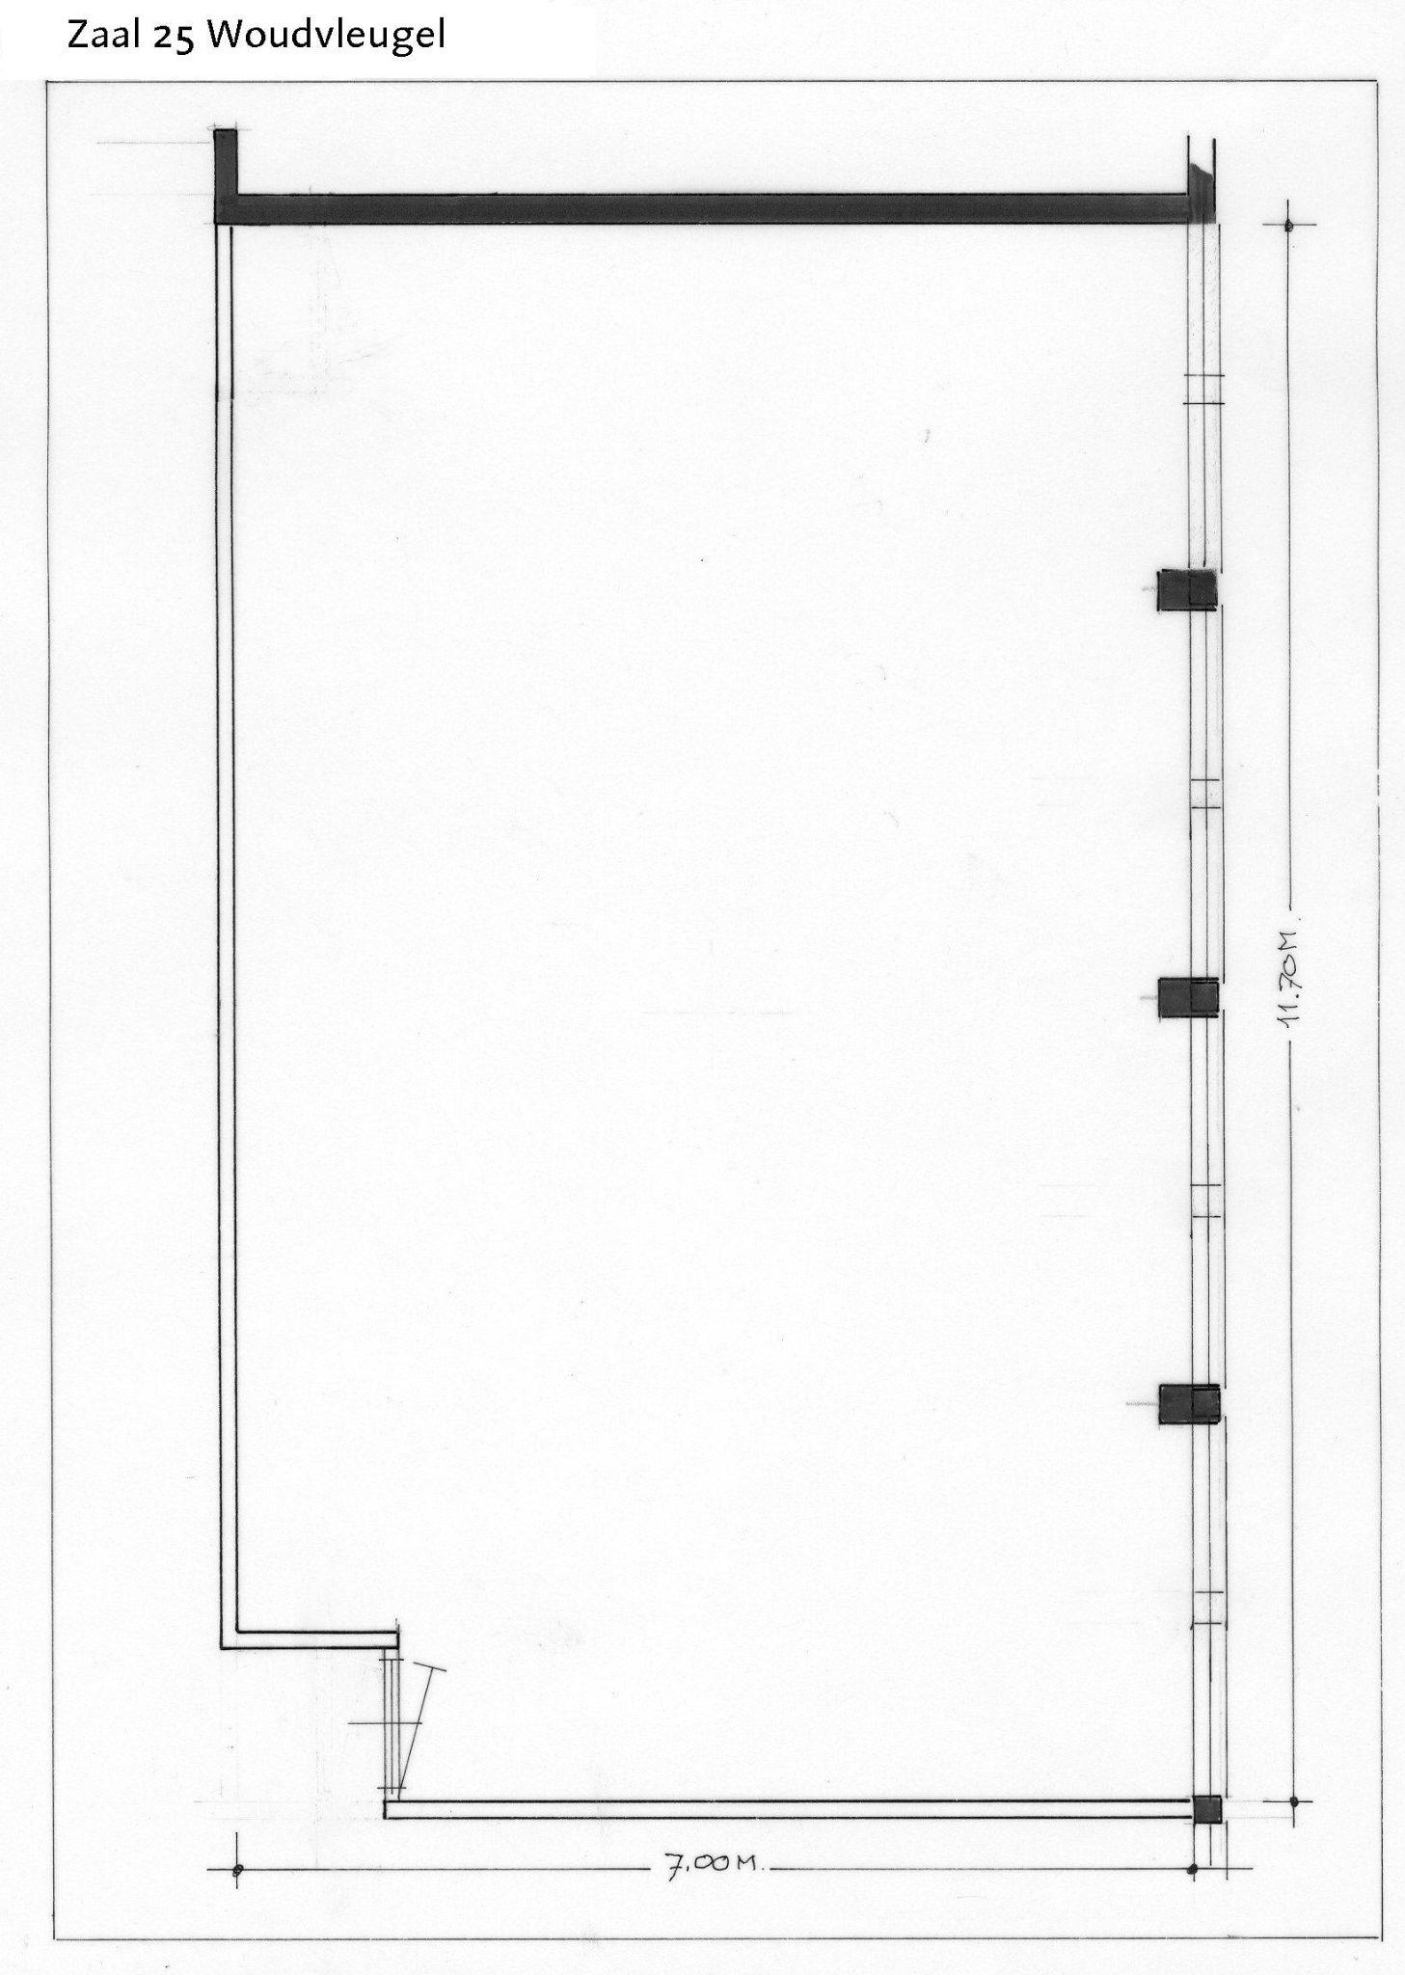
116
124
123
Novel methods [N = 14 (8/6)]
Section Random (Partly) – [N = 2 (0/2)]
N posters = 15
N boards = 10
Poster numbers: 116 t/m 130
* If it gets tight in any of the other rooms, some posters can be moved here
129
117
125
122
128
118
119
121
127
130
120
Day1
Day2

